Slide 1
Prepare your 7 minute presentation prior the scientific presentation class.
(Conference paper presentation preferred ). Please follow the format given here-after. Its rationale will be explained during the class.
This PowerPoint presentation is confidential to A-Star and may be privileged.If you are not the intended recipient, please delete it and notify LAU_Soh_Leng@a-star.edu.sg immediately. Please do not copy or disclose its content to any other person as it may be an offence under the Official Secrets Act. Thank you.

Slide 2

5 to 7 slides - 7 minutes
Title
Hook
Normal
Normal
Normal
Normal
Summary

Slide 3

Title Slide
Your title
Your name
Your Institute name and logo
A-Star Logo (if required)‏
Acknowledgments
A visual if hook is on title slide

Slide 4

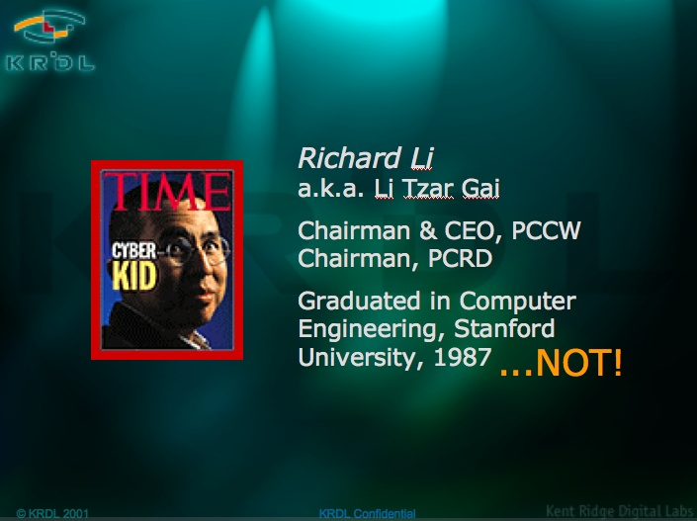
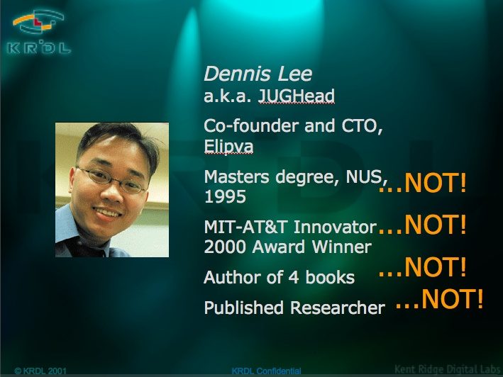
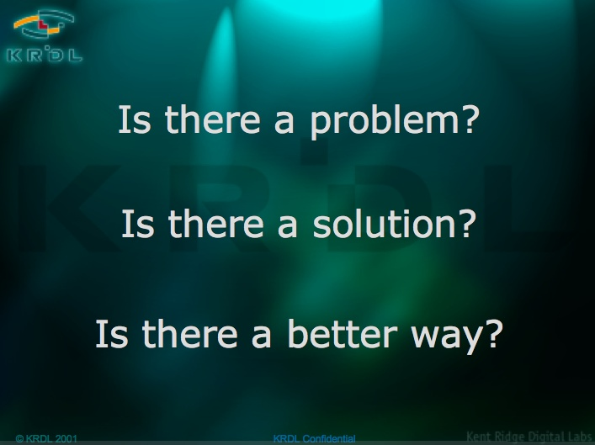

Hook Slide
What?
Where?
Surprising result
Problem, question
Reason for research
Before title slide
After title slide
On title slide

Slide 5
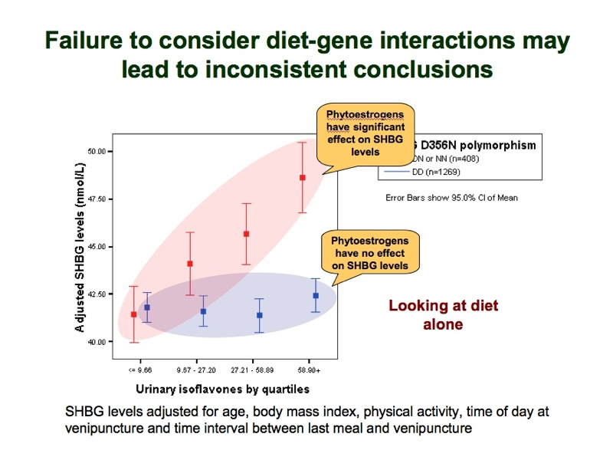
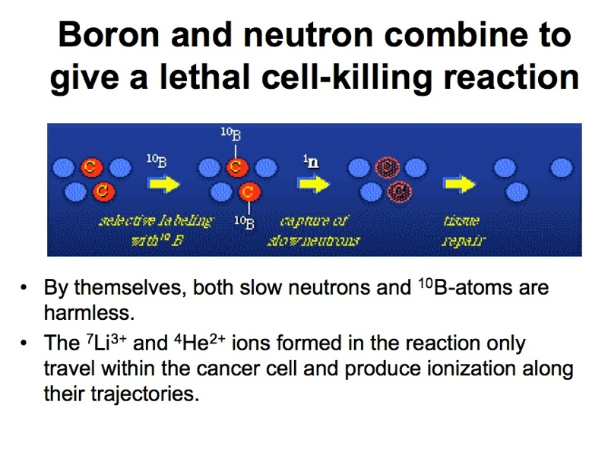
Normal Slide
Title is take-away (in full sentence form)‏
Rest of slide supports the title (visual or text or both) - one slide, one point only.

Slide 6
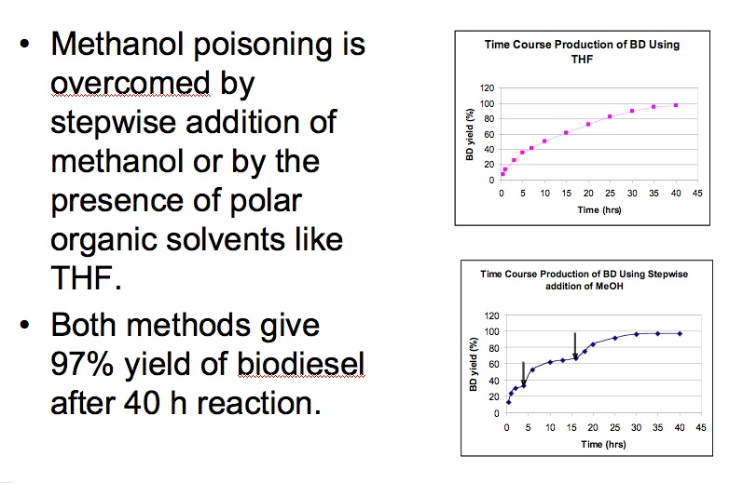
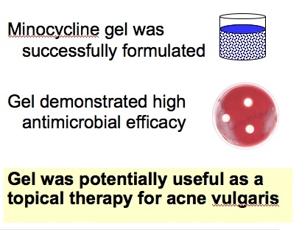
Summary slide
Two or three main points
Miniatures of their supporting visuals
Visuals hyperlinked to corresponding slide
To make a hyperlink: Select Action settings menu, “hyperlink to” option, then slide #

Slide 7
Text designed to be readable
r
Use fonts without serif instead of serif fonts.
Use font size 24 and above, nothing less.
Use white background with black letters.
Avoid fluorescent colours, use saturated colours
Serif
Text
Text
Text
Text
Text 24
Text 18

Slide 8
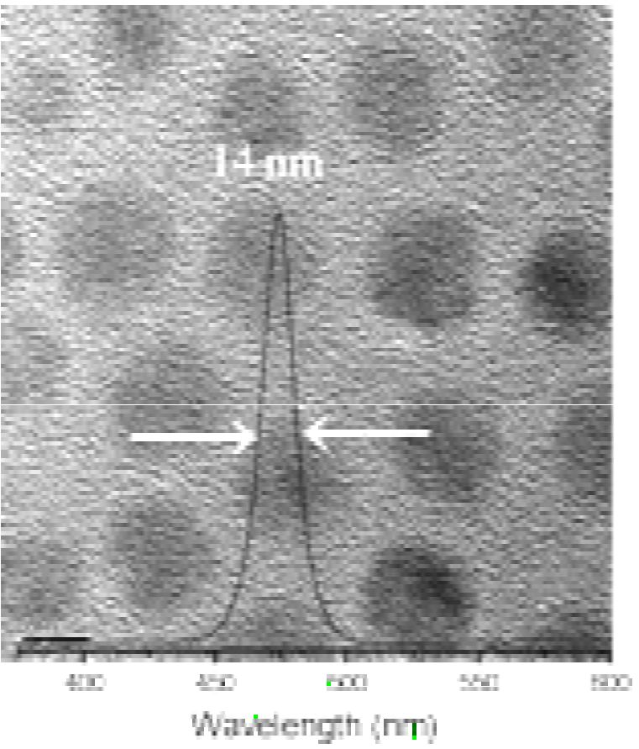
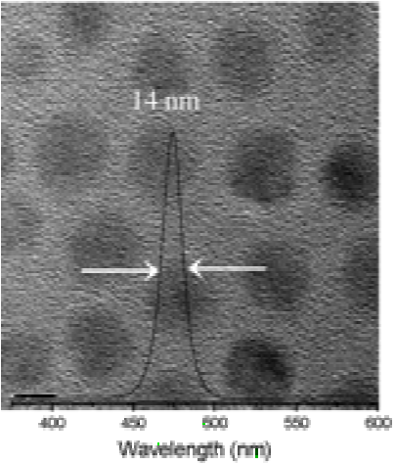
Images redrawn for readability
14nm
400
450
500
550
152*178 pixels
One pixel line
285*384 pixels
60% brightness
62% contrast
Wavelength (nm)‏

Slide 9
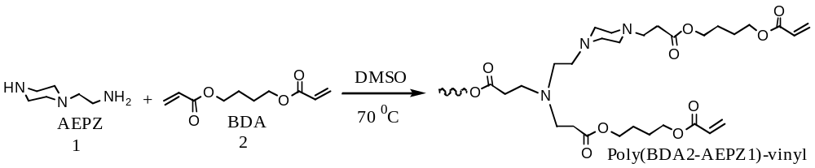
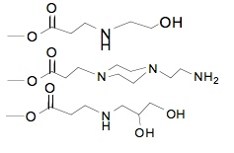
Attention drawn by design
Build interest with colour and reduce memory load by progressive disclosure (layering of information)‏
Use animation within, not between slides.
Synthesis of hyperbranched poly(amino ester)s
OH
NH2
Poly(BDA2-AEPZ1)-
(OH)2

Slide 10
11 key principles
Do not put on slide what you do not intend to present, to explain, or to be asked questions about.
Use bold sans serif white letters on a dark background, and bold black sans serif letters on pale backgrounds.
Increase contrast and colour saturation of images.
Redo or simplify all tables, formulas, chemical reactions, & visuals from your paper to increase readability.
The point of each slide is made in the top sentence: not what you did, but the result of what you did.
Rehearse with someone not familiar with your material.
Less is more.
Avoid using fluorescent or light colours for text and lines.
Never introduce new information in a conclusion slide.
The presentation is a story that is progressive, and logical.
Gestures and movement are human, stillness is robotic.

Slide 11
11 principles (for print)‏
1) Redo or simplify all tables, formulas, chemical reactions, & visuals from your paper to increase readability.
2) Do not put on slide what you do not intend to present, to explain, or to be asked questions about.
3) Less is more.
4) Rehearse with someone not familiar with your material.
5) Never introduce new information on a conclusion slide.
6) The presentation is a story that is progressive, and logical.
7) The point of each slide is made in the top sentence: not what you did, but the result of what you did.
8) Avoid using fluorescent or light colours for text and lines; Increase contrast and colour saturation of images.
9) Use bold sans serif white letters on a dark background, and bold black sans serif letters on a pale background.
10) Gestures and movement are human, stillness is robotic.
11) Redo or simplify all tables, formulas, chemical reactions, and visuals from your slides to increase readability.

